Slide 1

How engagement during out-of-school time STEM programs promotes the development of youths’ interest in STEM domains
Joshua M. Rosenberg, Patrick N. Beymer, & Jennifer A. Schmidt
Michigan State University

Slide 2
Background
Out-of-school time (OST) programs: summer and after-school educational contexts for youth
When high quality, have benefits (Hirsch, Kekinda, & Stawicki, 2010; Lauer, Akiba, Wilkerson, Apthorp, Snow, & Martin-Glenn., 2006)

Slide 3
OST STEM programs
Influx of programs focused on Science, Technology, Engineering, and Mathematics (STEM) domains (National Academy of Engineering and National Research Council)
Some evidence of effectiveness of OST STEM programs in supporting youths’ future goals and plans (Dabney et al., 2012; Elam et al., 2012)
Notes:
While many have suggested that contexts for learning outside of the school setting have an important role to play in youths’ development of interest,

Slide 4
Development of Interest in OST Programs
Little is known about whether and how youths’ motivation and interest in STEM domains develops (Bell, Lewenstein, Shouse & Feder, 2009)
Purpose: Examine whether and how youths’ engagement in summer STEM programming promotes development of interest

Slide 5
Interest development
Interests emerge from the interactions of an individual with the ideas, practices, and content of a domain (Hidi et al., 2004; Prenzel, 1992)
Develops in stages:
From (triggered and maintained) situational to (emerging and well-developed) individual interest (Hidi & Renninger, 2006)
Development involves cognitive, affective, and behavioral processes
Notes:
Triggered, maintained, emerging, well-developed

Slide 6
Conceptualizing engagement
Has multiple dimensions and is dynamic (Shernoff & Schmidt, 2008; Skinner & Pitzer, 2013)
Commonly conceptualized in terms of three dimensions (Christenson, Reschly, & Wylie, 2012; Fredricks, Blumenfeld, & Paris., 2004)
Behavioral engagement
Cognitive engagement
Affective engagement
Notes:
refers to one’s involvement in activities in terms of their effort and participation
refers to one’s mental investment in his or her own learning.
refers to one’s positive and negative feelings one has toward learning activities

Slide 7
Studying engagement
Methods such as the Experience Sampling Method (ESM) can be used to study engagement in a dynamic way
Assess real-time experiences in responded to randomly emitted signals (Hektner et al., 2007)
An intensive longitudinal method (Bolger & Laurencau, 2013)

Slide 8
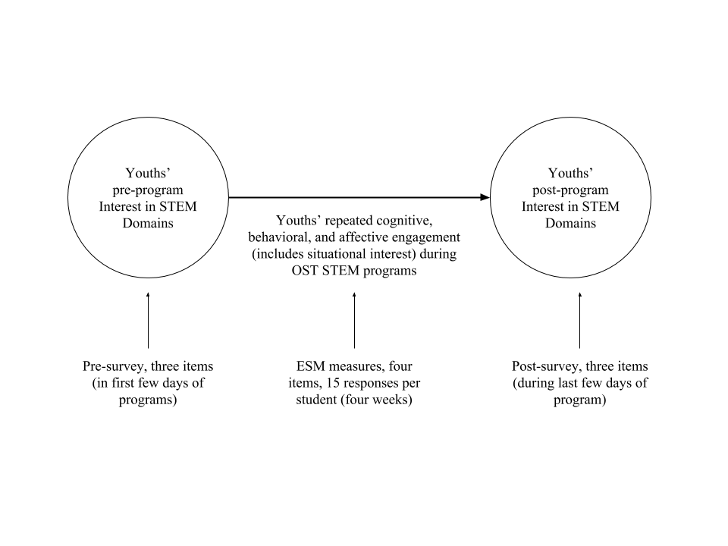
Notes:
Prior to the beginning of the program, youth completed a self-report survey to assess their post-program interest in STEM
Over the course of the each program, data were collected using ESM on youths’ overall engagement
Youth completed a second self-report survey at the end of the program to assess their post-program interest in STEM
Adolescents were signaled four times per day throughout six days of the program
The only condition for signaling was that each signal must occur at least 15 minutes apart
2,968 experience sampling responses were collected (M = 14.6)
Collected via ESM: Engagement
Working hard: As you were signaled, how hard were you working?
Concentrating: As you were signaled, how well were you concentrating?
Interest: Was the main activity interesting?
Enjoying: As you were signaled, did you enjoy what you are doing?
Collected via pre- and post-survey: Interest
I have always been fascinated by science/math/building
I am interested in Science/math/building
At school, science/math/building things is fun

Slide 9
Data analysis
Model 1:
Y_{predicted-engagement-i} = 𝛽₀ + ESM-engagement_{i}*𝛽₁ + gender_{j}*𝛽₂ + pre-interest_{j}*𝛽 + 𝜀_{i}
𝛽₀ = 𝛽₀₀ + engagement_{j}*µ₁
Model 2:
Y_{post-interest-i} = 𝛽₀ + predicted-engagement_{i}*𝛽₁ + gender_{j}*𝛽₂ + pre-interest_{j}*𝛽₃ + 𝜀_{i}
Notes:
Because of the observational design, use of sensitivity analysis (see Frank, 2000)
Pursued a one-step modeling approach (Houslay & Alastair, 2017)

Slide 10
Model 1 and Model 2 Results
Model 1: ESM engagement
Pre-interest (B = 0.10 (SE = 0.05), p = .033)
Female youth (B = -0.06 (0.09), p = .45)
Model 2: Post-interest
Pre-interest (B = 0.62 (0.06), p < .001)
Predicted engagement (B = 0.46 (0.10), p < .001, partial R² = .340)
Female youth (B = -0.14 (0.11), p = .239)

Slide 11
Model 1 and Model 2 Results
Model 1: ESM engagement
Pre-interest (B = 0.10 (SE = 0.05), p = .033)
Female youth (B = -0.06 (0.09), p = .45)
Model 2: Post-interest
Pre-interest (B = 0.62 (0.06), p < .001)
Predicted engagement (B = 0.46 (0.10), p < .001, partial R² = .340)
Female youth (B = -0.14 (0.11), p = .239)

Slide 12
Model 1 and Model 2 Results
Model 1: ESM engagement
Pre-interest (B = 0.10 (SE = 0.05), p = .033)
Female youth (B = -0.06 (0.09), p = .45)
Model 2: Post-interest
Pre-interest (B = 0.62 (0.06), p < .001)
Predicted engagement (B = 0.46 (0.10), p < .001, partial R² = .340)
Female youth (B = -0.14 (0.11), p = .239)

Slide 13
Key findings (predicting engagement)
Pre-program interest predicted in-the-moment engagement
Though the effect was small (and 6% bias needed to invalidate inference)
Gender did not predict youths’ in-the-moment engagement
Notes:
say specifically the past research found (in OST programs)
Dimensions of engagement that we used to consider the development of individual interest

Slide 14
Key findings (predicting engagement)
Being interested before the program is strongly related to being interested after
Sustained engagement predicted changes in youths’ interest
53% of effect needs to be due to bias to invalidate this inference
Being engaged in programs, rather than simply attending, is key
Notes:
For every one-unit change in their predicted engagement (when engagement is measured on a one-four scale), interest in STEM (also measured with a one-four scale) after the program was .46 units greater

Slide 15
Key findings: Alternate (one-step) approach
One-step (MCMC) approach yielded similar inferences
Partial R² from the mixed effects modeling = .34
Partial R² from from MCMC modeling = .27
Could be used to avoid making potentially spurious inferences (Houslay & Wilson, 2017)
Notes:
integrate into previous slide

Slide 16
Limitations
Considering behavioral, cognitive, and affective engagement separately
Use self-report measures
Simple models
Notes:
To this end, person-oriented analyses, and analytic approaches such as Latent Profile Analysis, hold promise for understanding how the dimensions of engagement are experienced by youth.
Researchers can also explore other outcomes, such as changes in youths’ future goals and plans and their competence.

Slide 17
Implications
Experiences that youth have in summer STEM programs matter
Greater opportunities for youth to engage in OST STEM programs
Methodological and data analytic approach could also be used for other data sources, such as online microworlds (Gobert, Baker, & Wixon, 2015)

Slide 18
Questions & contact information
Thank you for your time
We welcome your questions and feedback on this study
Joshua M. Rosenberg (jrosen@msu.edu, http://jmichaelrosenberg.com), Patrick N. Beymer, and Jennifer A. Schmidt

